Slide 1


BEACON your AI-Powered Command Center
Guiding you to a better future
Real-Time Multi-Sensory Learning & Session Analysis to Empower Children with Autism
Secure Platform For Human-Centered Care & Analysis
Compliance Framework
FSI-Grade Vault & HIPAA-Aware

Slide 2
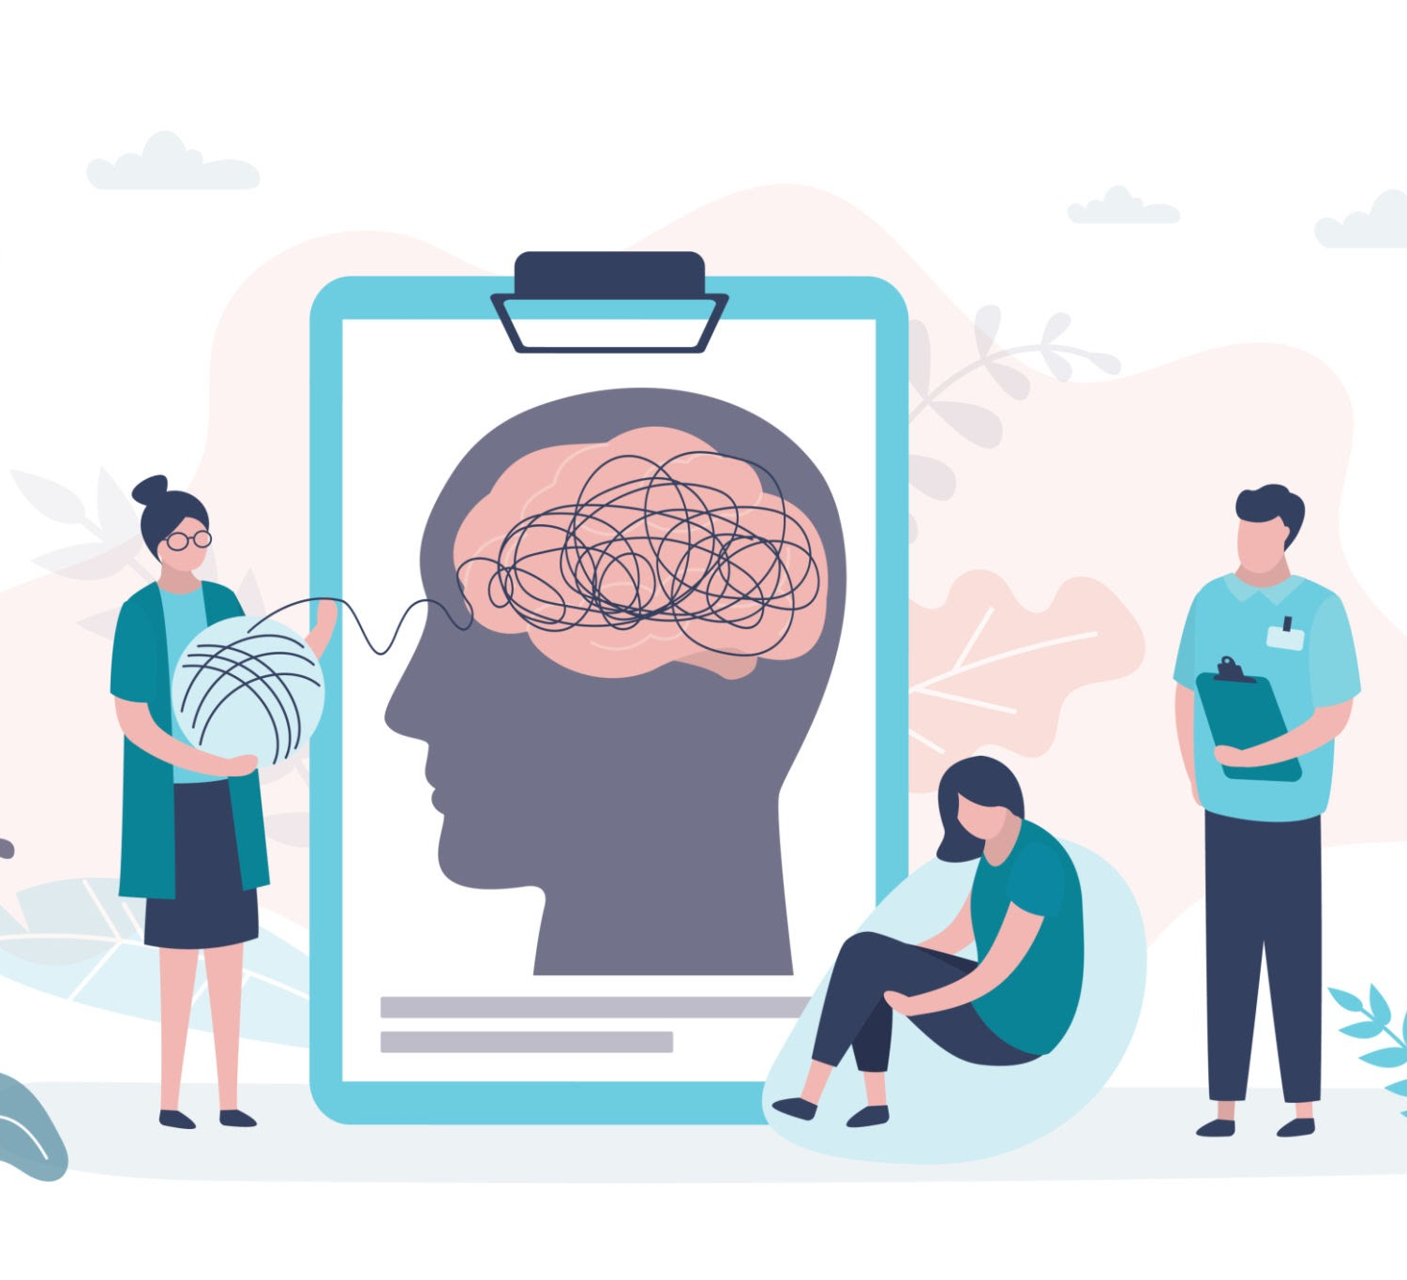




Therapy & Learning Challenges Today
Attention Split During Session
Time-Intensive Data Review
Subjective Data Capture
Documentation Burnout
Professionals should focus entirely on the child in front of them — not the clipboard.

Slide 3

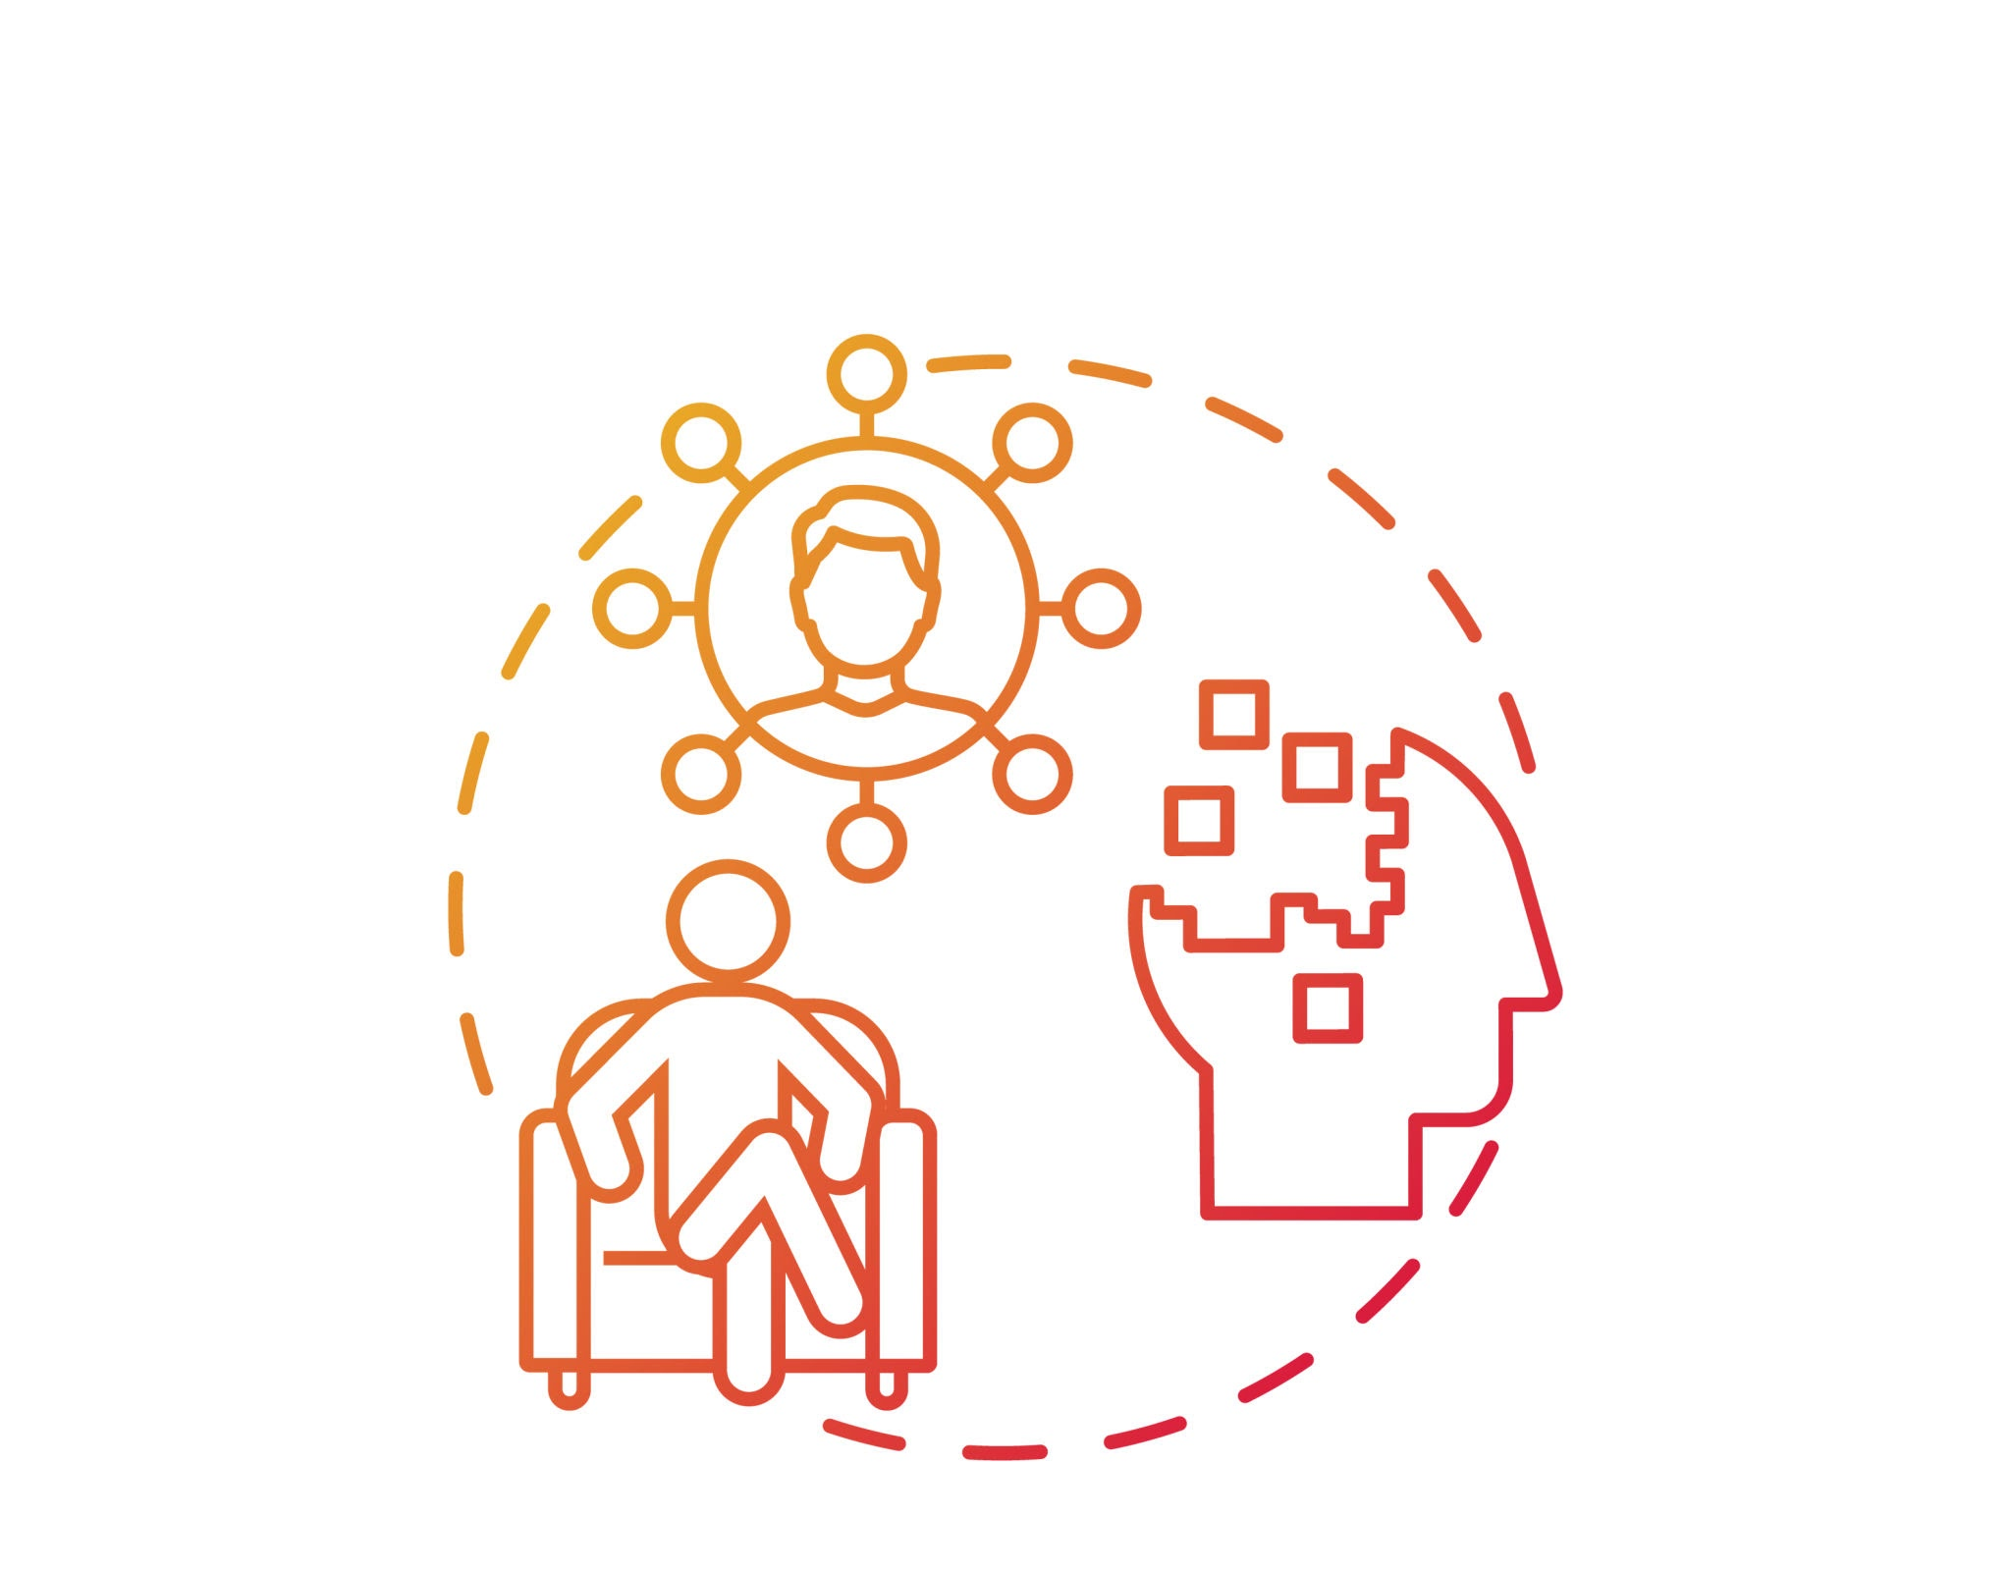


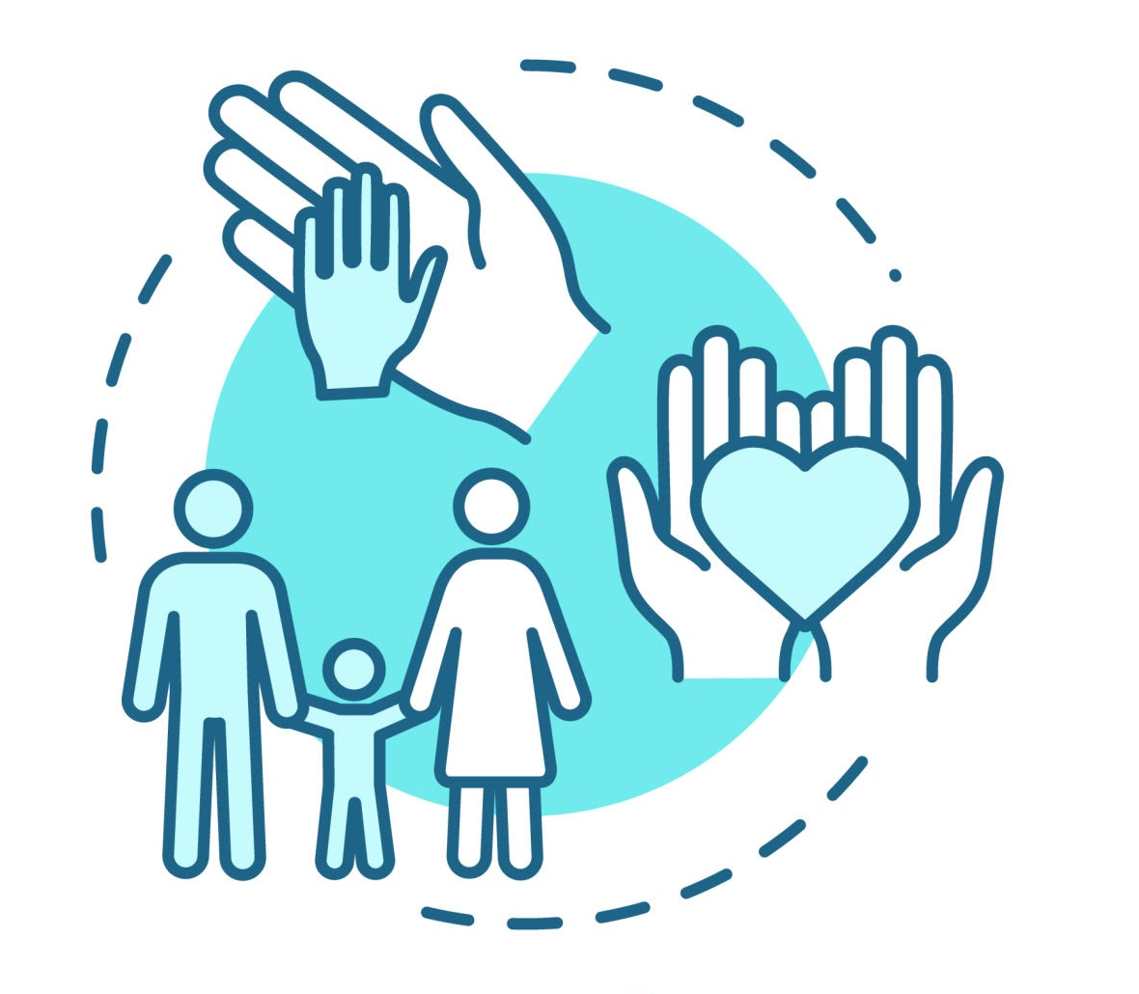
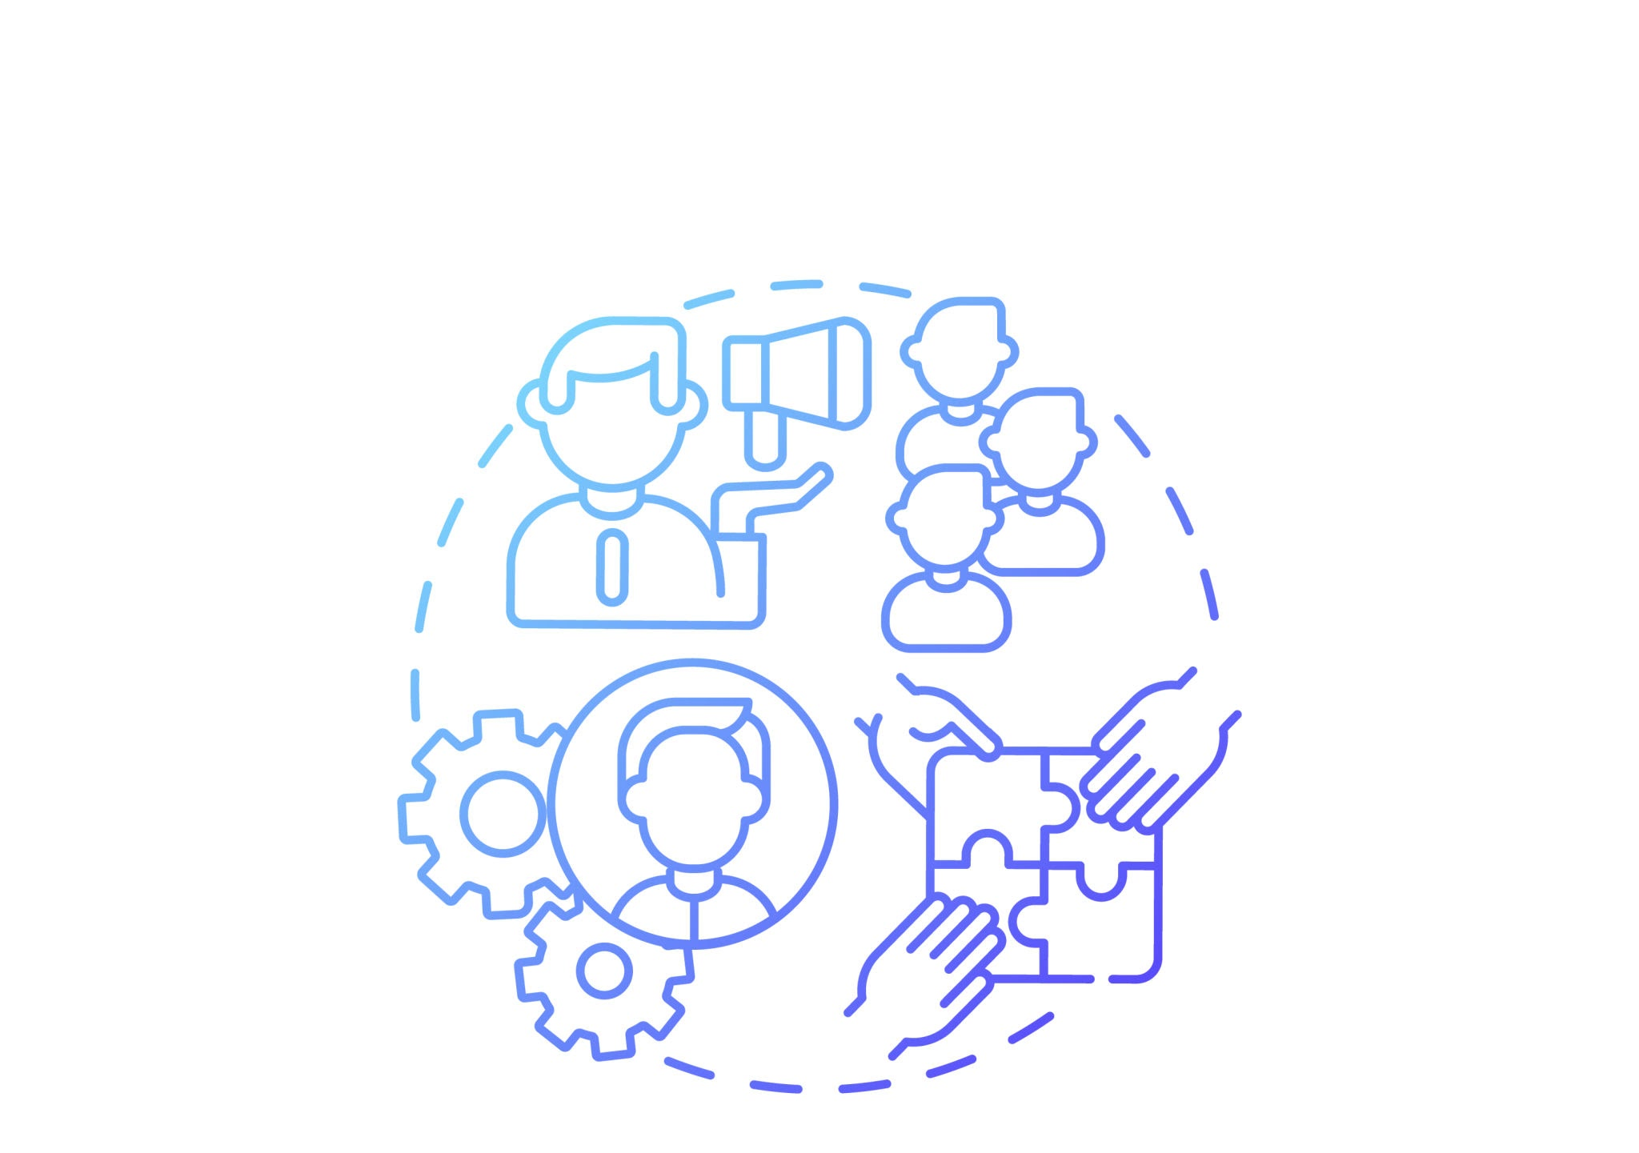
What if we had an AI Command Center to review the data for you?
Operational Benefits
Reduce documentation time
Improve session consistency
Accelerate reporting workflows
User Impact
Better therapist engagement
Improved learner outcomes
Enhanced quality of care
Market Opportunities
Digital health
EdTech
Enterprise learning
Behavioral analytics
Behavioral Specialists
Parents & Caregivers
Learning & Development Professionals

Slide 4


Meet Our Interdisciplinary Team
Architecture & Engineering
Design & Analysis
Mark — Core Framework & Command Center Engineer
Pratha — Visual Interactive Prototype Dashboard
Vikas — Audio Input & Real-Time Stream Processing
Paloma — Bio-Acoustic Analytics & Interpretation
Kevin — AI Transcription & Diarization Pipeline
Sophie — User Experience Story, Strategy & Presentation
Rajaniesh — Presentation and Visual storyTelling

Slide 5





Interdisciplinary Workstreams
1. Input & Analysis
2. AI Interpretation
3. Display Dashboard
Kevin & Vikas: Building ingestion services for low-latency voice, decibel, and frequency analysis alongside transcription.
Paloma & LLM Core: Mapping auditory and phonetic metrics into autism-specific cognitive markers (scripting, stimming, echoes).
Pratha, Mark: Structuring a real-time, highly legible dashboard to visualize session health, triggers, and focus metrics.

Slide 6


Therapy Session Simulation
Multisensory Context Extraction
During a therapy session the Command Center processes live metrics securely:
Audio Intake: Live decibel trackers identify spikes denoting sensory distress.
Phrase Matching: Scripting scripts are compared with historic child thresholds.
Post-Session Output: Auto-generated HIPAA summary is ready in seconds.

Slide 7

Session Metric Formulations
Algorithmic Engagement (E) Index
92%
FSI Ingestion Rate & Pipeline Accuracy
Weights ( ) dynamically balance attention and stimming offsets.

Slide 8
Enterprise-Grade Google Cloud Stack
Service Category | Google Cloud Component | Strategic Hackathon Application
Compute & Security | Cloud Run & Secret Manager | Serverless compute containerization with secure API token storage.
Data Ingestion | Cloud Storage & Cloud SQL | Secure storage for audio clips; PostgreSQL for clinical session records.
Event Ingestion | Pub/Sub Messaging | Sub-millisecond event streaming between pipelines for active alerting.
AI Processing | Speech-to-Text & Vertex AI Gemini | Fast transcripts; LLMs identify audio stimming, echoes, and trigger cues.

Slide 9


Robust Backend & Analytics Pipeline
Real-Time Processing Layer
FSI & HIPAA Analytics Store
The audio system performs multi-layered processing during session streams:
Structured insights are saved securely for therapist dashboard rendering:
Zero-Trust Storage: Cloud-native isolation to prevent cross-tenant access.
Speaker Diarization: Separating child, therapist, and environment voices.
Consent Workflows: Strict opt-in mechanics before record flags are initialized.
Bio-Acoustics: Recording speed, pitch tremble, and decibel fluctuations.
Clinical Suggestions: Vertex AI pipeline translates summaries into suggestions.
Semantic Parsing: Screening transcriptions for scripted words or echo tags.

Slide 10
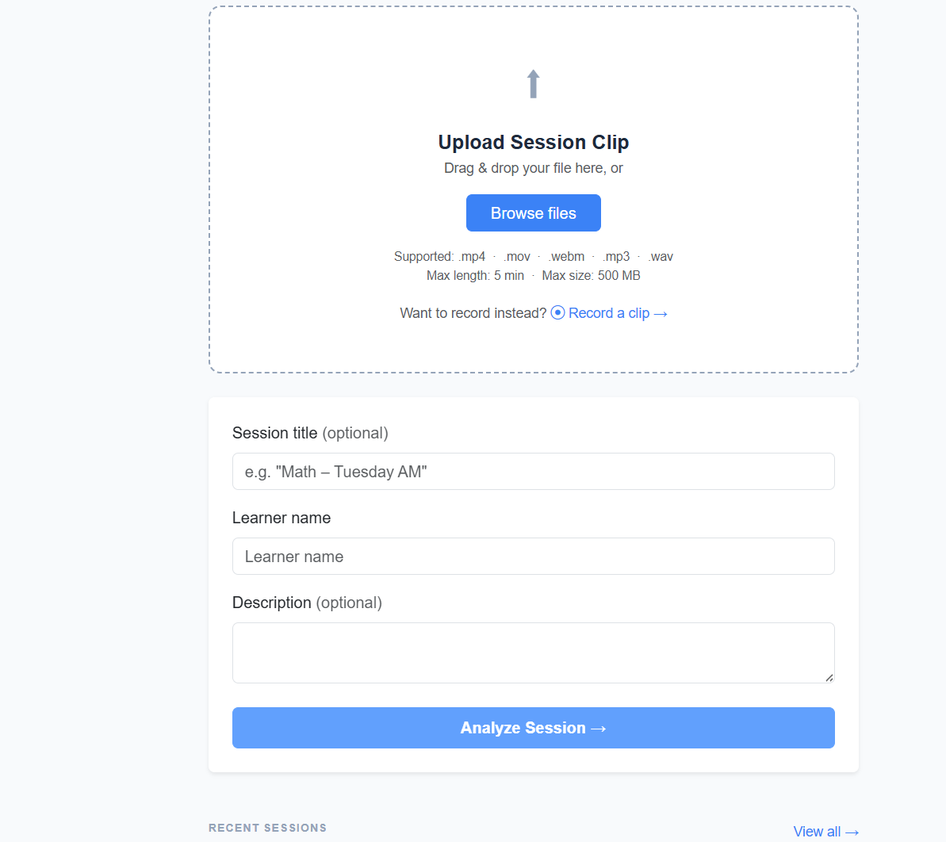
System Strengths
What Makes Us Unique
Multi-Sensory Synthesis: Rather than voice-to-text, our software correlates speech tone dynamics with emotional markers simultaneously.
FSI Security Standards: Built with zero-trust storage components, implementing robust isolation parameters and fully auditable secure logs.
Human-Centric Focus: Supporting the clinician, keeping them connected with the child, and removing clipboard distractions.

Slide 11
Ethical Safeguards & Secure Guardrails
FSI Encrypted Vaults: Every single record is encrypted at rest and in transit using hardware keys monitored by Google Cloud Security tools.
Privacy First & Explicit Consent: Multi-stakeholder digital keys must be provided to initiate live processing or archive logs.
Human-In-The-Loop (HITL): AI algorithms suggest therapy reports but clinicians retain complete review, override, and submission control.
Automated PII Redaction: Identifying details are scrubbed locally before analysis requests proceed to LLM processors.

Slide 12
Current MVP Scope vs. Roadmap
Product Phase | Core Feature Status | User Benefit
Functional MVP | Secure audio upload along with upload history, pipeline diarization, and clinical dashboard indicators. | Immediate post-session summary templates.
Stretch Goal | Enterprise Analytics Suite | Interactive dashboard support system
Roadmap Target | Longitudinal session trend visualizer with adaptive child threshold modeling. | Long-term therapeutic validation.

Slide 13
Strategic System Growth Roadmap
Q2 - Hackathon MVP
Q3 - Integrations
Q4 - Smart Feedback
2027 - Scaling
Establish essential Google Cloud streaming framework and speech-to-text transcriptions.
Deploy smart API endpoints and dashboard modules into existing clinical CRM suites.
Deliver AI therapist recommendations, visual charts, and trend metrics.
Enterprise deployments in specialized schools and pediatric systems globally.

Slide 14



Keep Professionals Human
Our AI Command Center transforms therapy and learning sessions into measurable,
actionable insights — allowing professionals to focus on people, not paperwork.
Questions?
Open Floor Discussion

